Slide 1
Syracuse University
Project Advance
Forensic Science chemistry 113
Senior Science Elective
at
River Dell Regional High School
Teacher Recommendation Required

Slide 2
Ppt presentation
is on the
J.PAWLOWSKI eboard!

Slide 3
Link to SUPA Forensic science…
http://supa.syr.edu/courses/courses.php?action=getDetails&classname=che113&course=chemistry
The following eight slides are excerpts from the Syracuse University Project Advance website with expressed permission for presentation purposes.

Slide 4
Welcome to Syracuse University!
Syracuse University's Project Advance allows you to get a head start in college by enrolling in SU courses while still in high school. Not only will you have the opportunity to earn SU college credit, you will better prepare yourself for the coming year.
Accepting this challenge shows that you are a serious student who wants to make the most out of your educational career. Colleges recognize this effort and will reward you for your work by accepting the transfer credit, exempting you from a required course, or by placing you in a higher-level course.

Slide 5
Chemistry 113, Forensic Science, is focused upon the application of scientific methods and techniques to crime and law. Recent advances in scientific methods and principles have had an enormous impact upon law enforcement and the entire criminal justice system. This course is intended to provide an introduction to understanding the science behind crime detection. Scientific methods specifically relevant to crime detection and analysis will be presented with emphasis placed upon the techniques used in evaluating physical evidence. Topics included are blood analysis, organic and inorganic evidence analysis, microscopic investigations, hair analysis, DNA, drug chemistry and toxicology, fiber comparisons, paints, glass compositions and fragmentation, fingerprints, soil comparisons, and arson investigations, among others. Laboratory exercises will include techniques commonly employed in forensic investigations.

Slide 6
Course introduction
: Definition and scope of forensic science, history and development of forensic science, the organization of a crime laboratory, services of the crime laboratory, the functions of the forensic scientist, other forensic science services.
The Crime Scene: Processing the crime scene, legal considerations at the crime scene.
Physical Evidence: Common types of physical evidence, the significance of physical evidence.

Slide 7
Physical Properties: The metric (SI) system, physical properties of glass and soil, comparing glass fragments, glass fractures, collection and preservation of glass evidence, forensic characterization of soil, collection and preservation of evidence.
Organic Analysis: Elements and compounds, selecting an analytical technique, chromatography, spectrophotometry, mass spectrometry.
Inorganic Analysis: Evidence in the assassination of President Kennedy, the emission spectrum of elements, atomic absorption spectrophotometry, the origin of emission and absorption spectra, neutron activation analysis, X-ray diffraction.
The Microscope: The compound microscope, the comparison microscope, the stereoscopic microscope, the polarizing microscope, the microspecrophotometer, the scanning electron microscope (SEM).

Slide 8
Hairs, Fibers and Paint: Morphology of hair, identification and comparison of hair, collection of hair evidence, types of fibers, identification and comparison of man-made fibers, collection of fiber evidence, forensic examination of paint, collection and preservation of paint evidence.
Drugs and Medicinal Chemistry: Drug dependence, narcotic drugs, hallucinogens, depressants, stimulants, anabolic steroids, drug-control laws, drug identification, collection and preservation of drug evidence.
Forensic Toxicology: Toxicology of alcohol, the role of the toxicologist, techniques used in toxicology, the significance of toxicological findings, the drug recognition expert.
Forensic Aspects of Arson and Explosion Investigations: The chemistry of fire, searching the fire scene, collection and preservation of arson evidence, analysis of flammable residues, types of explosives, collection and analysis of explosives.
Forensic Serology: The nature of blood, forensic characterization of bloodstains, stain pattern of blood, principles of heredity, forensic characterization of semen, collection of rape evidence.

Slide 9
DNA Evidence: What is DNA? DNA at work, replication of DNA, recombinant DNA: cutting and splicing DNA, DNA typing, mitochondrial DNA, the combined DNA index system, the collection and preservation of biological evidence for DNA analysis.
Fingerprints: History of fingerprinting, fundamental principles of fingerprints, classification of fingerprints, automated fingerprint identification systems, methods of detecting fingerprints, preservation of developed prints, digital imaging for fingerprint enhancement.
Firearms, Tool Marks and Other Impressions: Bullet comparisons, cartridge cases, automated firearm search systems, gunpowder residues, primer residues of the hands, serial number restoration, collection and preservation of firearm evidence, tool marks, other impressions.

Slide 10
Document and Voice Examination: Handwriting comparisons, collection of handwriting exemplars, typewriting comparisons, photocopies, printer and Fax examination, alterations, erasures and obliterations, other document problems, voice examination.
Forensic Science on the Internet: What is the internet? Where to go on the internet, exploring forensic science of the www, web sites you may wish to explore.

Slide 11
Laboratory
Experiments involve techniques frequently encountered in forensic investigations. These experiments will include: safety practices in the chemistry laboratory, separating and identifying food dyes by paper chromatography, identifying a solid by its density, classifying carbohydrates, enantiomeric purity of commercial ibuprofen, qualitative tests for amino acids and proteins, DNA extraction, nine bottles: an adventure in chemical identification, the crime scene (analysis of evidence).
Required Text
Saferstein, R. Criminalistics: An Introduction to Forensic Science, (9th ed.). Prentice Hall.

Slide 12
93% of Project Advance graduates who sent an official SU transcript or attended Syracuse University received recognition (credit, placement, and/or exemption) for their SU courses.
•93% of Project Advance graduates reported receiving an average grade of B or above through four years of college.
•95% of Project Advance graduates recommended SU courses offered through Project Advance.
•96% of principals and 90% of teachers involved with Project Advance felt SUPA helped students develop more realistic expectations of college work.
•92% of teachers involved with Project Advance found their jobs more challenging.
•92% of teachers involved with Project Advance reported they had been further exposed to new ideas and developments in their discipline.
Syracuse University is the only private university in the Northeast accredited by the National Alliance of Concurrent Enrollment Partnerships (NACEP).

Slide 13
Some Guest Speakers for Forensics
FBI Special Agent
Bergen County Prosecutor’s Office Detectives
Bergen County Sheriff’s Office Detectives
Bergen County Bureau of Crime Investigation
Local law enforcement patrolpersons
Bergen County Medical Examiner
Handwriting Expert

Slide 14
Field Trip to the Bureau of Crime Investigation
Hackensack, NJ
Students get the royal tour of the fingerprint, sketch artist, photographic and ballistics and firearms labs

Slide 15
Full year, two semester course
No additional lab period in schedule
Final Exam required

Slide 16
Required…
Recommendation by Chemistry teacher
Must be a senior
4 credits from Syracuse U
Payment much reduced from on campus courses

Slide 17
Case Studies
Novel Study
Crime scene
Laboratory safety and knowledge a requirement

Slide 18
Criminal cases
Civil cases
Historical cases

Slide 19
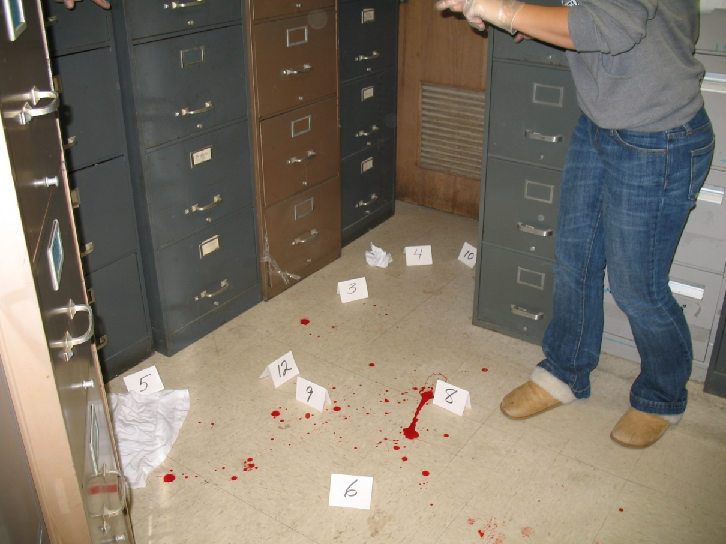

Slide 20
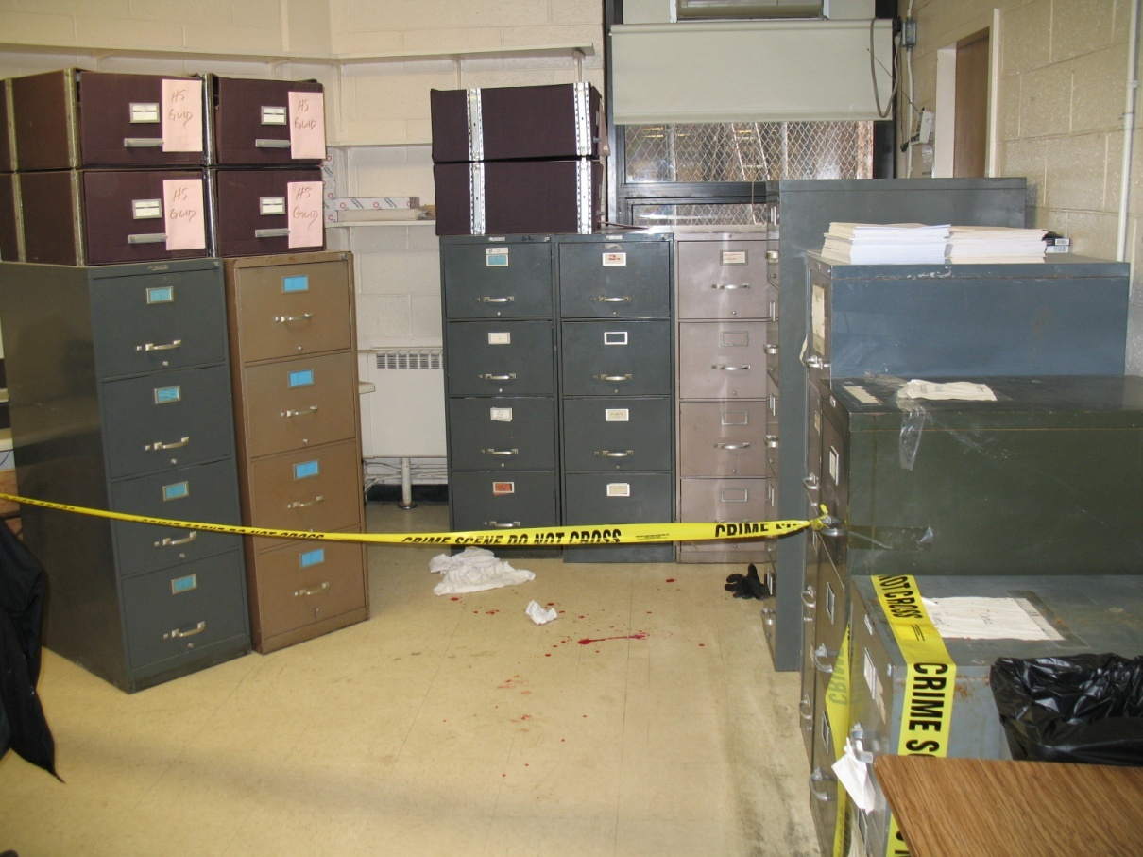

Slide 21
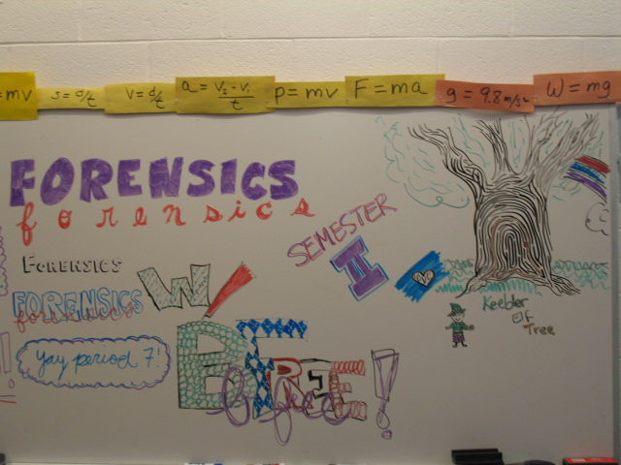

Slide 22
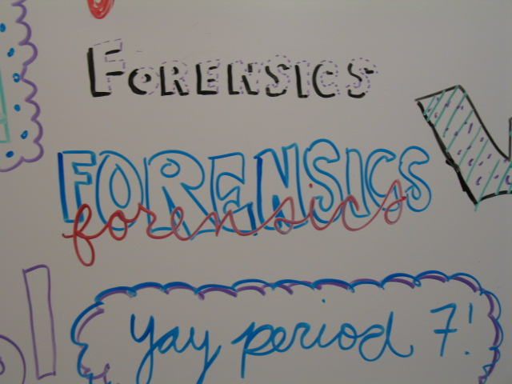

Slide 23
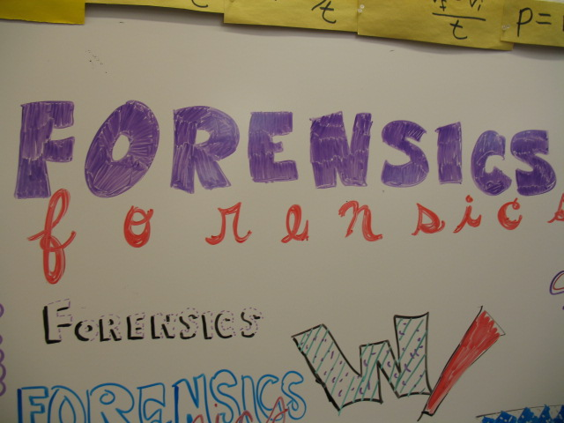

Slide 24
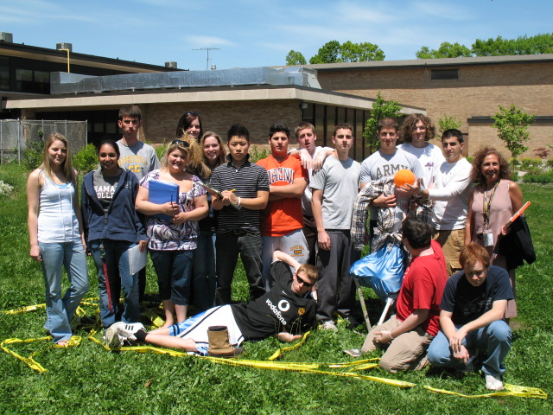

Slide 25


Slide 26


Slide 27
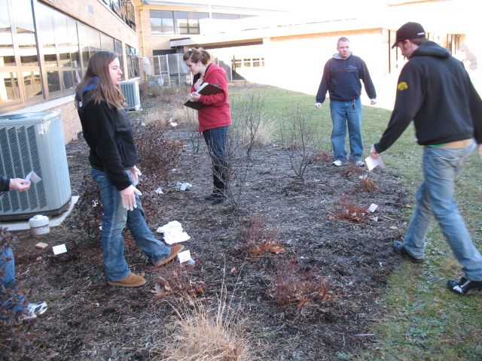

Slide 28
